Slide 1
Main Features of JAVA
Platform independent language
Compiler(javac) converts source code (.java file) to the byte code(.class file).
JVM executes the bytecode produced by compiler. This byte code can run on any platform such as Windows, Linux, Mac OS etc. Which means a program that is compiled on windows can run on Linux and vice-versa.
Each operating system has different JVM, however the output they produce after execution of bytecode is same across all operating systems. That is why we call java as platform independent language.

Slide 2
Object Oriented language
4 main concepts of Object Oriented programming are:
Abstraction
Encapsulation
Inheritance
Polymorphism

Slide 3
Simple
Java is considered as one of simple language because it does not have complex features like:
Operator overloading
Multiple inheritance
Pointers
Explicit memory allocation

Slide 4
Robust Language
Robust means reliable. Java programming language is developed in a way that puts a lot of emphasis on early checking for possible errors, that’s why java compiler is able to detect
The main features of java that makes it robust are:
Garbage Collection
Exception Handling
Memory Allocation.

Slide 5
Secure We don’t have pointers and we cannot access out of bound arrays (you get ArrayIndexOutOfBoundsException if you try to do so) in java.
Java is distributed: The java programs can be distributed on more than one systems that are connected to each other using internet connection. Objects on one JVM (java virtual machine) can execute procedures on a remote JVM.

Slide 6
Multithreading :Java supports multithreading. Multithreading is a Java feature that allows concurrent execution of two or more parts of a program for maximum utilisation of CPU.
Portable
As discussed above, java code that is written on one machine can run on another machine. The platform independent byte code can be carried to any platform for execution that makes java code portable.

Slide 7
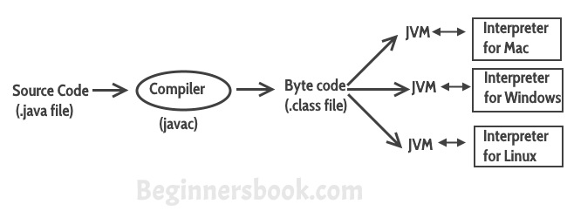

Slide 8
The javac compiler does this thing, it takes java program (.java file containing source code) and translates it into machine code (referred as byte code or .class file).
Java Virtual Machine (JVM) is a virtual machine that resides in the real machine (your computer) and the machine language for JVM is byte code.
JVM executes the byte code generated by compiler and produce output. JVM is the one that makes java platform independent.
Each operating system has different JVM, however the output they produce after execution of byte code is same across all operating systems. Which means that the byte code generated on Windows can be run on Mac OS and vice versa. That is why we call java as platform independent language.

Slide 9
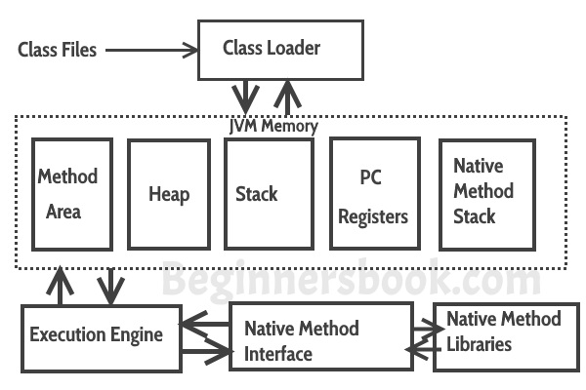
JVM Architecture

Slide 10
:Class Loader The class loader reads the .class file and save the byte code in the method area.
Method Area: There is only one method area in a JVM which is shared among all the classes. This holds the class level information of each .class file.
Heap: Heap is a part of JVM memory where objects are allocated. JVM creates a Class object for each .class file.
Stack: Stack is a also a part of JVM memory but unlike Heap, it is used for storing temporary variables.
PC Registers: This keeps the track of which instruction has been executed and which one is going to be executed. Since instructions are executed by threads, each thread has a separate PC register.
Native Method stack: A native method can access the runtime data areas of the virtual machine.
Native Method interface: It enables java code to call or be called by native applications. Native applications are programs that are specific to the hardware and OS of a system.
Garbage collection: A class instance is explicitly created by the java code and after use it is automatically destroyed by garbage collection for memory management.

Slide 11
Types of Variables in Java
There are 3 types of variables in Java.
1) Static variable
2) Instance variable
3) Local variable
Static variables are also known as class variable because they are associated with the class and common for all the instances of class.
Instance variable
Each instance(objects) of class has its own copy of instance variable. Unlike static variable, instance variables have their own separate copy of instance variable.

Slide 12
Local Variable
These variables are declared inside method of the class. Their scope is limited to the method which means that You can’t change their values and access them outside of the method.
How to Declare a variable in Java:
data_type variable_name = value;

Slide 13
Types of Operator in Java
1)Basic Arithmetic Operators
Basic arithmetic operators are: +, -, *, /, %
2) Assignment Operators ( = ) 3) Auto-increment and Auto-decrement Operators
++ and – - 4) Logical Operators 5) Comparison (relational) operators 6) Bitwise Operators 7) Ternary Operator

Slide 14
Logical and Relational Operators
b1&&b2 will return true if both b1 and b2 are true else it would return false.
b1||b2 will return false if both b1 and b2 are false else it would return true.
!b1 would return the opposite of b1, that means it would be true if b1 is false and it would return false if b1 is true
Comparison(Relational) operators We have six relational operators in Java: ==, !=, >, <, >=, <=

Slide 15
Bitwise Operators
There are six bitwise Operators: &, |, ^, ~, <<, >>
Bitwise operator performs bit by bit processing. num1 & num2 (AND)compares corresponding bits of num1 and num2 and generates 1 if both bits are equal, else it returns 0.
num1 | num2 (OR)compares corresponding bits of num1 and num2 and generates 1 if either bit is 1, else it returns 0. In our case it would return 31 which is 00011111
num1 ^ num2 (XOR) compares corresponding bits of num1 and num2 and generates 1 if they are not equal, else it returns 0.
~num1 is a complement operator that just changes the bit from 0 to 1 and 1 to 0.
num1 << 2 is left shift operator that moves the bits to the left, discards the far left bit, and assigns the rightmost bit a value of 0.
num1 >> 2 is right shift operator that moves the bits to the right, discards the far right bit, and assigns the leftmost bit a value of 0.

Slide 16
Operator Precedence in Java
Unary Operators ++ – – ! ~
Multiplicative * / %
Additive + –
Shift << >> >>>
Relational > >= < <=
Equality == !=
|
Bitwise AND &
Bitwise XOR ^
Bitwise OR Logical AND &&
Logical OR ||
Ternary ?:
Assignment = += -= *= /= %= > >= < <= &= ^= |=

Slide 17
If, If..else Statement in Java
a) if statement b) nested if statement c) if-else statement d) if-else-if statement

Slide 18
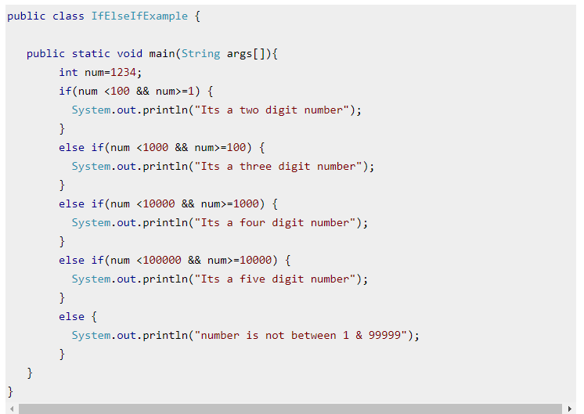
Output??

Slide 19
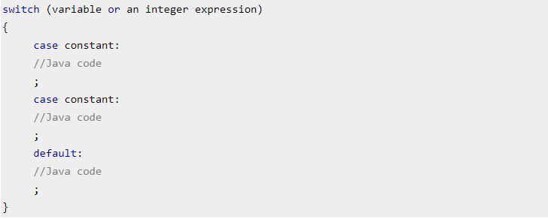
Switch Case statement in Java with example

Slide 20
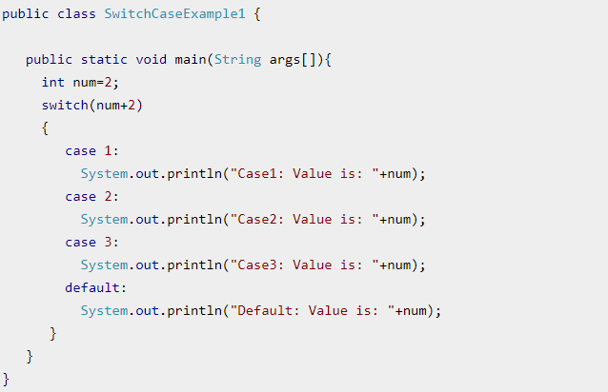
Switch Case Example

Slide 21
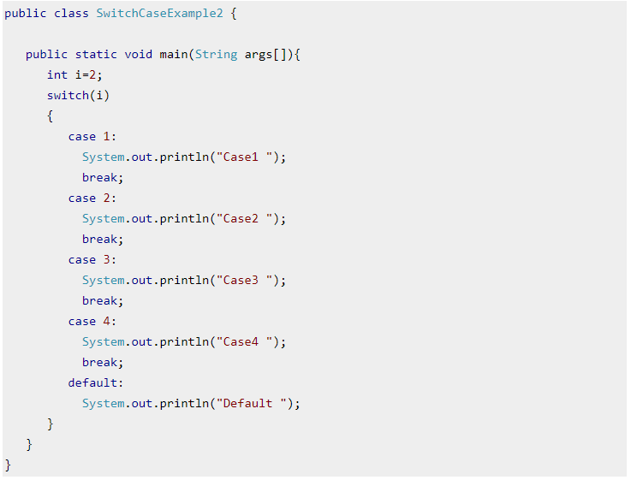
Switch with Break :

Slide 22
Important for Switch (For MCQ )
Few points about Switch Case
Case doesn’t always need to have order 1, 2, 3 and so on. It can have any integer value after case keyword. Also, case doesn’t need to be in an ascending order always, you can specify them in any order based on the requirement.
Use characters in switch case.
Nesting of switch statements are allowed, which means you can have switch statements inside another switch.

Slide 23
THANKS

